Slide 1

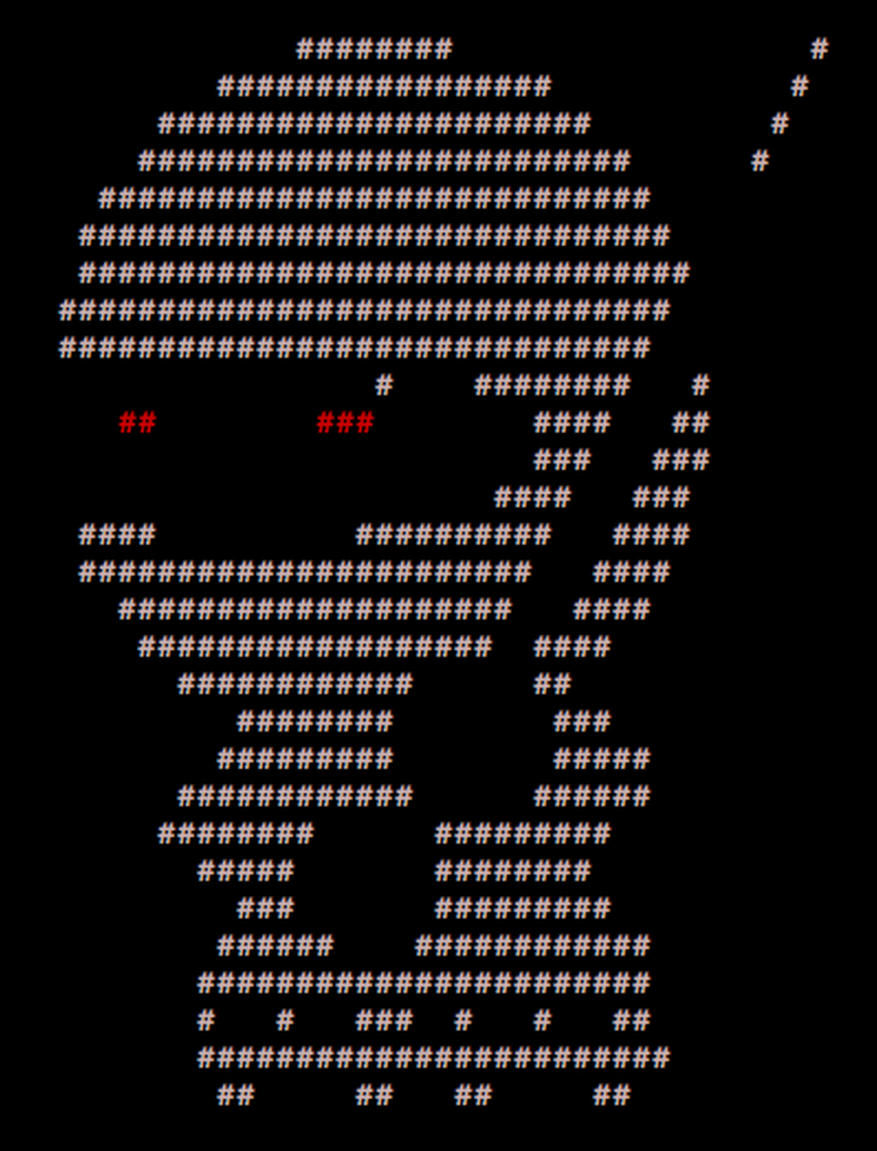
____ _____ _ _
/ ___| ___ __|_ _|_ _| | | _____
\___ \ / _ \/ __|| |/ _` | | |/ / __|
___) | __/ (__ | | (_| | | <\__ \
|____/ \___|\___||_|\__,_|_|_|\_\___/
PER0x55
Technical (in)security talks & hands-on challenges, no bullshit!
Technical (in)security talks & hands-on challenges, no bullshit!

Slide 2
Welcome!
We’re back!
Greetings nerds
Technical (in)security talks & hands-on challenges, no bullshit!

Slide 3
SecTalks PER0x55
Thanks to…
Evildaemond/BugCrowd for the brews!
Spacecubed & Riff!
The committee: nidogski & sudosammy
Everyone who contributes!
Technical (in)security talks & hands-on challenges, no bullshit!
Notes:
Have a line up of lightening talks tonight

Slide 4
Speakers PER0x55
#1 - drunkrhin0 - android stuff Synopsis: “I had to learn how to android pentest so i did it by watching a bunch of youtube videos this is what i learnt”
Bio: drunkrhin0 is very nice and helpful
Technical (in)security talks & hands-on challenges, no bullshit!
Notes:
Conor is an evolutionary mass of atoms whose sole instinct is survival. Works as a Security Analyst who primarily focuses on detection engineering and data analysis – finding data, gathering data, parsing data, employing that data to do wonderful things. He embodies the ‘fuck around and find out’ mindset and applies it to every project.

Slide 5
Speakers PER0x55
#2 - Eric - Keeping WA safe Synopsis: Contact tracing apps have recently risen in popularity with QR codes springing up all over the place. Fresh off the back of a coordinated disclosure, let's dive into a journey pentesting a government mandated contact tracing system. Bio: Eric's been running software engineering teams for a while now and has watched his systems being torn apart by pentesters in lots of weird and wonderful ways. In a true case of "if you can't beat them, join them" Eric now runs the Information Security capability at Cash Converters where he applies an engineering mindset to improving organisational security posture.
Technical (in)security talks & hands-on challenges, no bullshit!
Notes:
Conor is an evolutionary mass of atoms whose sole instinct is survival. Works as a Security Analyst who primarily focuses on detection engineering and data analysis – finding data, gathering data, parsing data, employing that data to do wonderful things. He embodies the ‘fuck around and find out’ mindset and applies it to every project.

Slide 6

SecTalks PER0x56
Date: ????
(the randomest day of every month)
Speaker: ??? ← This could be you!
Title: ??? ← This could be anything!
https://goo.gl/4FT53i
Technical (in)security talks & hands-on challenges, no bullshit!

Slide 7



Stay in touch
IRC / SLACK
irc.sectalks.org > #sectalks
and / or ask to be added to the slack
Github
https://github.com/sectalks/sectalks
Twitter
@SecTalks
Technical (in)security talks & hands-on challenges, no bullshit!

Slide 8
Without further ado...
drinks?
~ ~
( o )o)
( o )o )o)
(o( ~~~~~~~~o
( )' ~~~~~~~'
( )|) |-.
o| _ |-. \
o| |_||_) | \ \
| | ||_) | | |
o| | / /
| |." "
| |- '
.========.
Technical (in)security talks & hands-on challenges, no bullshit!

